Slide 1
Lesson 5 Timing an FPGA VI
Timing Express VIs
Implementing Loop Execution Rates
Creating Delays Between Events
Measuring Time Between Events
Benchmarking Loop Periods

Slide 2
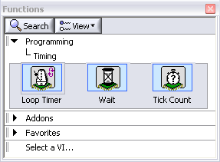
A. Timing Express VIs
Loop Timer Express VI
Implementing Loop Rates
Wait Express VI
Creating Delays Between Events
Tick Count Express VI
Benchmarking
Notes:
A. Timing Express VIs
The Timing palette contains most of the FPGA timing Express VIs, except those related to the Timed Loop. Timing control is critical to your FPGA application. The timing Express VIs include the Loop Timer, Wait, and Tick Count Express VIs.
Use the Loop Timer Express VI to control a For Loop or While Loop and set the iteration rate of the loop. A common use of the Loop Timer Express VI is to control the acquisition or update rate of an analog or digital I/O function.
The Wait Express VI adds an explicit delay between two operations on the FPGA. Use the Wait Express VI to control the pulse length of a digital output or add a trigger delay between the trigger signal and the resulting operation.
The Tick Count Express VI returns the current value of the FPGA clock. Use the Tick Count Express VI to benchmark loop rates or create your own custom timers.

Slide 3

B. Implementing Loop Execution Rates
Use the Loop Timer Express VI
Waits the value you specify in Count between loop iterations
Controls the period of a loop
Place the Loop Timer Express VI inside a loop
Perform I/O operations at a specific frequency
Control loop execution rate
Notes:
LabVIEW Help:
FPGA Module»Creating FPGA VIs»Using FPGA Clocks and Timing»Using the FPGA Timing Functions
VI Help for Loop Timer Express VI… see details section

Slide 4
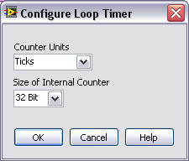
Configure Loop Timer
Counter Units
Ticks — clock cycles
µSec — microseconds
mSec — milliseconds
Size of Internal Counter
32 Bit
16 Bit
8 Bit
Size of Internal Counter determines the maximum time a timer can track.
To save space on the FPGA, use the smallest Size of Internal Counter possible.

Slide 5
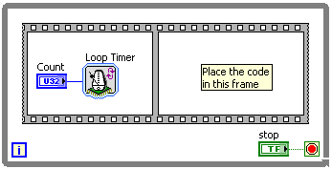
Loop Timer Express VI Functionality
First iteration
Records current time as initial time
Immediately executes the code in the next frame without any delay
Second iteration
Adds Count to initial time and waits until Count has elapsed from the initial recorded time
Executes the code in the next frame after Count has elapsed
Subsequent iterations
Loop Timer continues to increment the time record it initiated upon the first call
Does not reset each time
Notes:
Second execution adds timer count to initial time and waits until count has elapsed
If Loop Timer is parallel to code in the loop (meaning no sequence structure)
First iteration not guaranteed to be synchronized with the desired timing
Code in loop can execute twice within first desired loop time
Subsequent iterations match desired timing synchronization.
Info from Loop Timer VI Help… see Details section

Slide 6
Loop Timer Express VI Caveat
If an execution instance is missed, such as when the logic in the loop takes longer to execute than the specified Count:
Loop Timer returns immediately and establishes a new reference time stamp for subsequent calls
No delay
Notes:
LV Help»FPGA Module»Creating FPGA VIs»Using FPGA Clocks and Timing»Using the FPGA Timing Functions
VI Help for Loop Timer Express VI… see details section
“If the time specified by the Count is less than the time it takes the FPGA target to execute the code in the While Loop, the Loop Timer VI does not affect the timing of the While Loop.”

Slide 7
Implementing Loop Execution Rates
Watch out for rollover
Size of Internal Counter determines the maximum time the timer can track
Size of Internal Counter | Ticks | μs | ms
32-bit | 1 to 4,294,967,296 ticks | 1 μs to 71 minutes | 1 ms to 49 days
16-bit | 1 to 65,536 ticks | 1 μs to 65 ms | 1 ms to 65 seconds
8-bit | 1 to 256 ticks | 1 μs to 256 us | 1 ms to 256 ms
Notes:
Each timing Express VI has a configuration dialog box that appears when you first add the VI to the block diagram or when you right click the VI and select Properties. The dialog box allows you to configure the timing units and the size of the internal counter. The available Counter Units include ticks; a single clock cycle, the length of which is determined by the clock rate for which the VI is compiled; microseconds (µs), and milliseconds (ms). The Size of Internal Counter value determines the maximum time the timer can track. The free running counter rolls over when the counter reaches the maximum of Size of Internal Counter specified in the configuration dialog box. To save space on the FPGA, you should use the smallest Size of Internal Counter possible for the FPGA VI.
The configuration dialog box for the Loop Timer Express VI includes the following options:
Counter Units—Unit of time the VI uses for the counter.
Ticks—Sets the counter units to a single clock cycle, the length of which is determined by the clock rate for which the VI is compiled.
mSec—Sets the counter units to µs.
mSec—Sets the counter units to ms.
Size of Internal Counter—Specifies the maximum time (8, 16, or 32 bits) a timer can track. To save space on the FPGA, use the smallest.

Slide 8
Tick Period
Tick period is based on the frequency of the FPGA clock
If using a 40MHz FPGA clock, the tick period is 25ns
Must use ticks for nanosecond timing
Size of Internal Counter | Ticks | μs | ms
32-bit | 1 to 4,294,967,296 ticks | 1 μs to 71 minutes | 1 ms to 49 days
16-bit | 1 to 65,536 ticks | 1 μs to 65 ms | 1 ms to 65 seconds
8-bit | 1 to 256 ticks | 1 μs to 256 us | 1 ms to 256 ms
Notes:
Each timing Express VI has a configuration dialog box that appears when you first add the VI to the block diagram or when you right click the VI and select Properties. The dialog box allows you to configure the timing units and the size of the internal counter. The available Counter Units include ticks; a single clock cycle, the length of which is determined by the clock rate for which the VI is compiled; microseconds (µs), and milliseconds (ms). The Size of Internal Counter value determines the maximum time the timer can track. The free running counter rolls over when the counter reaches the maximum of Size of Internal Counter specified in the configuration dialog box. To save space on the FPGA, you should use the smallest Size of Internal Counter possible for the FPGA VI.
The configuration dialog box for the Loop Timer Express VI includes the following options:
Counter Units—Unit of time the VI uses for the counter.
Ticks—Sets the counter units to a single clock cycle, the length of which is determined by the clock rate for which the VI is compiled.
mSec—Sets the counter units to µs.
mSec—Sets the counter units to ms.
Size of Internal Counter—Specifies the maximum time (8, 16, or 32 bits) a timer can track. To save space on the FPGA, use the smallest.

Slide 9
cRIO Module Loop Execution Rates
Some cRIO modules have configurable timing
Do not need to use Loop Timer Express VI to time loop rate
Example
NI 9233
You can configure the data rate at which the NI 9233 module acquires and returns data
Static/Programmatic Configuration
C-Series Module Properties dialog box
FPGA I/O Property Node

Slide 10
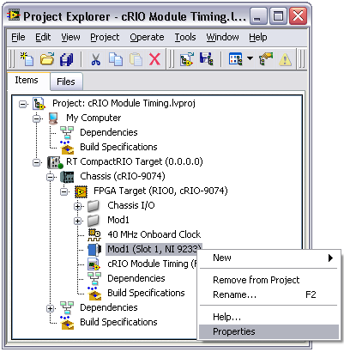
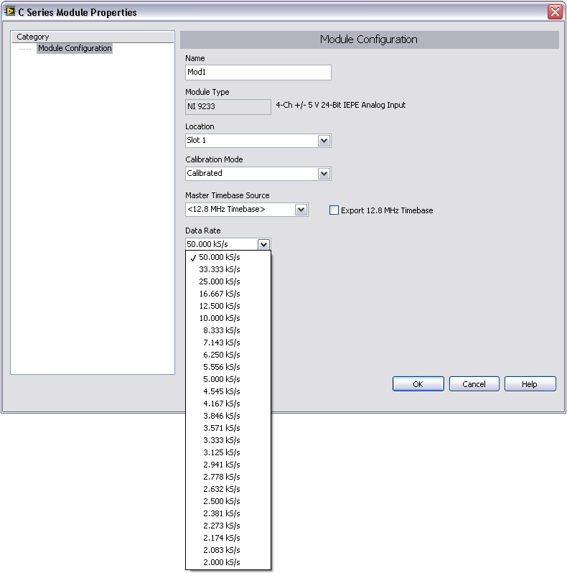
Static Configuration of NI 9233 Data Rate

Slide 11
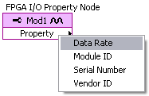

Programmatic Configuration of NI 9233 Data Rate

Slide 12
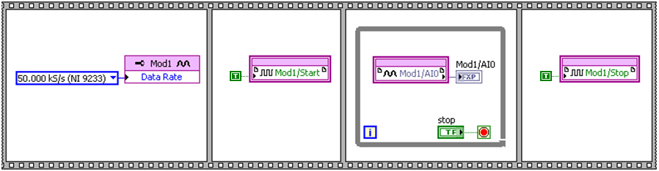
cRIO Module Loop Execution Rates
Loop Timer Express VI is not needed
While Loop rate is determined by NI 9233 data rate
If other code in the loop executes at a slower rate, the loop rate will be limited by the other code

Slide 13
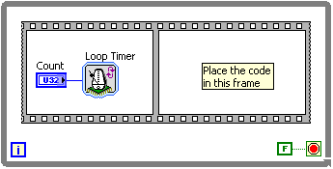
Loop Conditional Terminal
False constant is acceptable
FPGA logic is often meant to run indefinitely on the FPGA
Controls and application logic is still acceptable
Notes:
Wiring a false constant to the Loop Condition terminal of a While Loop is acceptable in many FPGA applications. FPGA logic is often meant to run indefinitely on the FPGA. Wiring controls and application logic to the Loop Condition terminal instead is also acceptable.

Slide 14
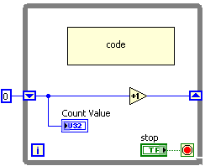
While Loop Iteration Terminal Maximum
The iteration terminal count will keep outputting 2,147,483,647 once it reaches this value
If you need a counter to rollover when it reaches its maximum value, you should implement your own counter
Notes:
The iteration terminal count of the While Loop does not rollover. Instead, it will keep outputting 2,147,483,647 once it reaches that value. With FPGA speeds, it is possible for the While Loop iteration terminal to max out rather quickly.
If you need a counter to rollover when it reaches its maximum value, you should programmatically implement your own counter.

Slide 15
Exercise 5-1: While Loop Timing
Use the Loop Timer Express VI to time a While Loop running on an FPGA VI.
Notes:
Prep discussion:
The student is assigned the task of creating an FPGA VI that acquires data from the Connector0\AI0 analog input channel of a PCI-7831R FPGA board. If the data value is higher than the user-specified limit, then the FPGA VI must output a high voltage on the Connector0\DIO0 digital output line. The FPGA VI must execute these I/O operations at a user-specified sample interval.
The student will use the Loop Timer Express VI to time the code in a While Loop.

Slide 16
Exercise 5-1: While Loop Timing
If the code in the second frame of the Sequence structure takes longer to execute than the value of AI Sample Time control, how long would each iteration of the While loop take?
Notes:
Each iteration of the While Loop will last the same amount of time it takes to execute the code in the second frame of the Sequence structure.
Because the logic in the loop takes longer to execute than the specified interval of the Loop Timer, the Loop Timer returns immediately and establishes a new reference time stamp for subsequent calls.

Slide 17
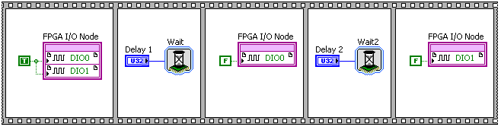
C. Creating Delays Between Events
Use Wait Express VI to create a delay between events
Examples
Create delay between a trigger and subsequent output
Create a series of delays
Notes:
Creating Delays between Events
Use the Wait Express VI to create a delay between events in an FPGA VI. For example, you might want to create a delay between a trigger and a subsequent output. You can place the LabVIEW code for the trigger in the first frame of a sequence structure. Then place the Wait Express VI in the following frame. Finally, place the LabVIEW code for the output in the last frame of the sequence structure. You also can create a series of delays using multiple Wait VIs in a sequence structure, as shown in the following block diagram.
Block diagram screenshot shown in from LV Help»Creating FPGA VIs»Using FPGA Clocks and Timing»Using the FPGA Timing Functions.

Slide 18
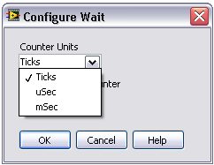
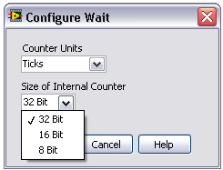
Wait Express VI Configuration
Counter Units
Size of Internal Counter
Determines maximum possible wait time

Slide 19
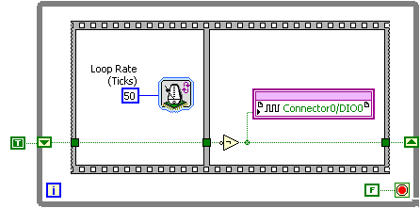
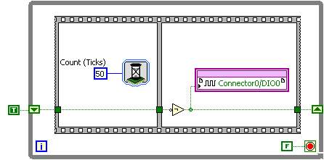
Comparing Loop Timer and Wait VIs
Code structure is the same
Loop Timer does not wait the first time it is called
Wait Express VI waits every iteration of the While Loop
Notes:
You can time your FPGA code using the Loop Timer Express VI or the Wait Express VI. The Loop Timer and Wait Express VIs differ in how they affect code execution.
If you use the Loop Timer Express VI, during the first iteration the code executes right away. If you use the Wait Express VI, during the first iteration the code waits for the duration of the specified wait statement.
For both cases, the options for choosing the timing units and the counter size are available.
The Flat Sequence structure controls the flow of data and ensures that the wait occurs before the value on the digital output changes.

Slide 20

D. Measuring Time Between Events
Tick Count Express VI
Returns the value of a free-running FPGA counter in the units specified
Use Tick Count Express VI to measure time between events
Examples
Measure the time between edges on a digital signal
Determine the execution time of a section of code

Slide 21
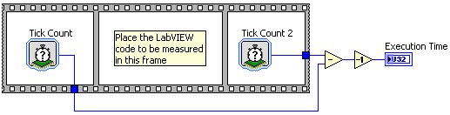
Measuring Time Between Events
Calculate the difference between the results of two Tick Count Express VIs to determine the execution time
Subtract one from the result of the calculation to compensate for the execution time of the Tick Count Express VI
Notes:
From LV Help»FPGA Module»Creating FPGA VIs»Using FPGA Clocks and Timing»Using the FPGA Timing Functions
Measuring Time between Events
Use the Tick Count Express VI to measure the time between events such as edges on a digital signal. You can use the Tick Count Express VI when you need to determine the period, pulse-width, or frequency of an input signal or if you want to determine the execution time of a section of LabVIEW code.
For example, to determine the amount of time it takes a function or a section of LabVIEW code to execute, use a sequence structure with two Tick Count Express VIs, as shown in the following block diagram.
Place one Tick Count Express VI in the first frame of the sequence structure. Then place the LabVIEW code you want to measure in the second frame of the sequence structure. Finally, place the other Tick Count Express VI in the last frame of the sequence structure. You then can calculate the difference between the results of the two Tick Count Express VIs to determine the execution time. Subtract one from the result of the calculation to compensate for the execution time of the Tick Count Express VI.
The Tick Count Express VI has an internal counter to track time. The internal counter for each Tick Count Express VI you place on the same block diagram shares the same start time. Therefore, every Tick Count Express VI that uses the same values for the Counter Units and Size of Internal Counter options tracks the same time. For example, if you call two Tick Count Express VIs that use the same Configure Tick Count options at the same time, they return the same Tick Count value.
The Tick Count Express VI returns an integer value in Counter Units. The Tick Count value cannot represent any fractional time periods that might occur when Counter Units is configured for uSec or mSec. Configuring Counter Units for uSec or mSec can result in timing measurements that have an accuracy of ±1 Counter Unit value. For example, you can configure the Tick Count Express VIs in the block diagram above to measure time in milliseconds. If the first Tick Count Express VI executes at 47.9 milliseconds, Tick Count returns a value of 47. If the second Tick Count Express VI executes at 53.2 milliseconds, Tick Count returns a value of 53. Although this example has a 5.3 millisecond delay, the difference between the returned values is 6 milliseconds.

Slide 22
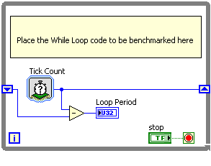
E. Benchmarking Loop Periods
Use Tick Count Express VI to measure loop periods
Calculate the time difference
Remove the benchmarking code later
Benchmarking code executes in parallel
Does not add additional time to the loop period
Notes:
The figure above shows an example that uses the Tick Count Express VI to benchmark the loop period of a While Loop.
Timestamp measurements are done in parallel because of the way the FPGA code is implemented. As long as any new code is not made within the same combinatorial path as another set of code the code execution times are independent from one another. Because of this behavior, whenever you add code to an FPGA VI for benchmarking, it has no affect on the loop execution time, provided that the code you are benchmarking takes longer to execute than the three ticks required to obtain and observe the loop rate.

Slide 23
Tick Count Rollover
Watch out for rollover
If the code you are benchmarking takes more than the maximum value Tick Count can handle, the elapsed time will be much lower than expected due to rollover
Size of Internal Counter | Ticks | μs | ms
32-bit | 1 to 4,294,967,296 ticks | 1 μs to 71 minutes | 1 ms to 49 days
16-bit | 1 to 65,536 ticks | 1 μs to 65 ms | 1 ms to 65 seconds
8-bit | 1 to 256 ticks | 1 μs to 256 us | 1 ms to 256 ms
Notes:
Benchmarking Loop Rates
It is important to benchmark the rate at which a VI runs. Because the FPGA code runs on the FPGA hardware, you cannot determine the precise timing until you compile the code. After you compile the code, the Tick Count Express VI to benchmark the VI and determine execution speed.
You must be careful of Tick Count rolling over. Because Tick Count has a maximum representation of 32 bits, the greatest number of ticks that it can count before returning to 0 is 2³² = 4,294,967,296. However, when the clock runs at 40 MHz, the clock rolls over about every 107 seconds. If the code you are benchmarking takes more than 107 seconds to execute, the elapsed time result will be much lower than expected because the final Tick Count rolled over to 0.

Slide 24
Exercise 5-2: While Loop Benchmarking
Benchmark the loop period of a While Loop containing code.
Notes:
Prep discussion:
The student is given a pre-built VI containing code in a While Loop. The student will add benchmarking code to the While Loop to display its loop period in units of Ticks. The student then converts the number of Ticks into the number of milliseconds.

Slide 25
Exercise 5-2: While Loop Benchmarking
If you configured the Tick Count Express VI to use Counter Units of μs or ms instead of Ticks, would the benchmarking results in this exercise still be reasonable?
If the code you want to benchmark executes within nanoseconds, what Counter Unit should you use?
Notes:
Yes, because the code you benchmark in this exercise has an execution time of about 70ms.
Ticks. You can then convert the amount of Ticks into nanoseconds (number of ticks / FPGA clock frequency * 1,000,000,000)

Slide 26
Summary—Matching Quiz
Loop Timer Express VI
Wait Express VI
Tick Count Express VI
Use to create delays between events
Use to benchmark execution speeds
Use to control loop execution rate

Slide 27
Summary—Matching Quiz Answers
Loop Timer Express VI
Wait Express VI
Tick Count Express VI
Use to create delays between events
Use to benchmark execution speeds
Use to control loop execution rate

Slide 28
Summary—Quiz
What is a potential drawback of using an 8-bit counter instead of a 32-bit counter?
Decreased FPGA resources used
32-bit clocks are slower
Maximum time the timer can track is not large enough for the application
Notes:
Answer is c.

Slide 29
Summary—Quiz Answer
What is a potential drawback of using an 8-bit counter instead of a 32-bit counter?
Decreased FPGA resources used
32-bit clocks are slower
Maximum time the timer can track is not large enough for the application
Notes:
Answer is c.

Slide 30
Summary—Quiz
True or False? If you place a Loop Timer Express VI inside a While Loop, the Loop Timer Express VI will wait during every iteration of the While Loop.
Notes:
Answer is False. The Loop Timer Express VI will not wait the first iteration of the While Loop because it will only record the initial time. Also, the Loop Timer Express VI will not wait if the execution time of the code in the While Loop exceeds the time specified by the Count input of the Loop Timer Express VI.

Slide 31
Summary—Quiz Answer
True or False? If you place a Loop Timer Express VI inside a While Loop, the Loop Timer Express VI will wait during every iteration of the While Loop.
False
Notes:
Answer is False. The Loop Timer Express VI will not wait the first iteration of the While Loop because it will only record the initial time. Also, the Loop Timer Express VI will not wait if the execution time of the code in the While Loop exceeds the time specified by the Count input of the Loop Timer Express VI.

Slide 32
Summary—Quiz
True or False? Adding benchmarking code to a While Loop will not affect the execution speed of the loop.
Notes:
Answer is True. The benchmarking code will execute in parallel with the code in the While Loop, so the benchmarking code will not add any additional time to the loop period.

Slide 33
Summary—Quiz Answer
True or False? Adding benchmarking code to a While Loop will not affect the execution speed of the loop.
True
Notes:
Answer is True. The benchmarking code will execute in parallel with the code in the While Loop, so the benchmarking code will not add any additional time to the loop period as long as the code in the While Loop takes longer to execute than the benchmarking code.

